Slide 1

IIIT Bhubaneswar
Department Of Computer Secience & Engineering

Slide 2
MAJOR PROJECT PRESENTATION
Designing a Web Interface for Finding Human Body Pose Estimation
Project Members Name
Shrey Sahay B421047
Piyush Kumar Nayak B521044
Hemant Sah
B421025

Slide 3
Introduction
Human Pose Estimation :
Uses machine learning to estimate spatial locations of body joints (key points) from images or videos.
It identifies key points like shoulders, elbows, knees, etc.
Helps track the position and movement of body joints.
Project Aim : Demonstrate real-time pose estimation using Pose Net and webcam feed.
Technology Used : TensorFlow.js – A JavaScript library for training and deploying ML models in the browser.

Slide 4
Constraints
Scope Boundaries
Focus is limited to 2D Pose Estimation (X and Y coordinates of key points).
3D Pose Estimation is excluded for simplicity.
We estimate both single and multi-person poses.
Implementation runs in a web browser environment.
No training of ML models is done manually.
Uses JavaScript libraries with pre-trained ML capabilities.
Access to models is done via simple import commands.

Slide 5
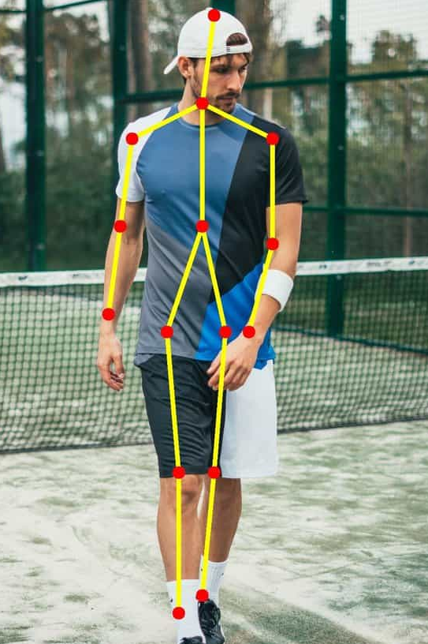

Pose estimation
Definition: Technique for detecting and tracking human body parts in real-time video or images.
Explanation: Uses computer vision and machine learning to locate and determine orientation of body parts.
Use cases:
Human action recognition
Human-computer interaction
Video surveillance
Fitness & Health tracking
Gesture recognition

Slide 6
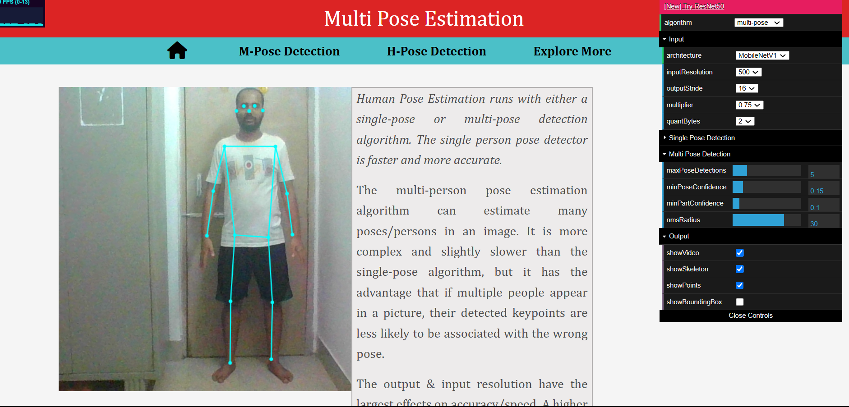
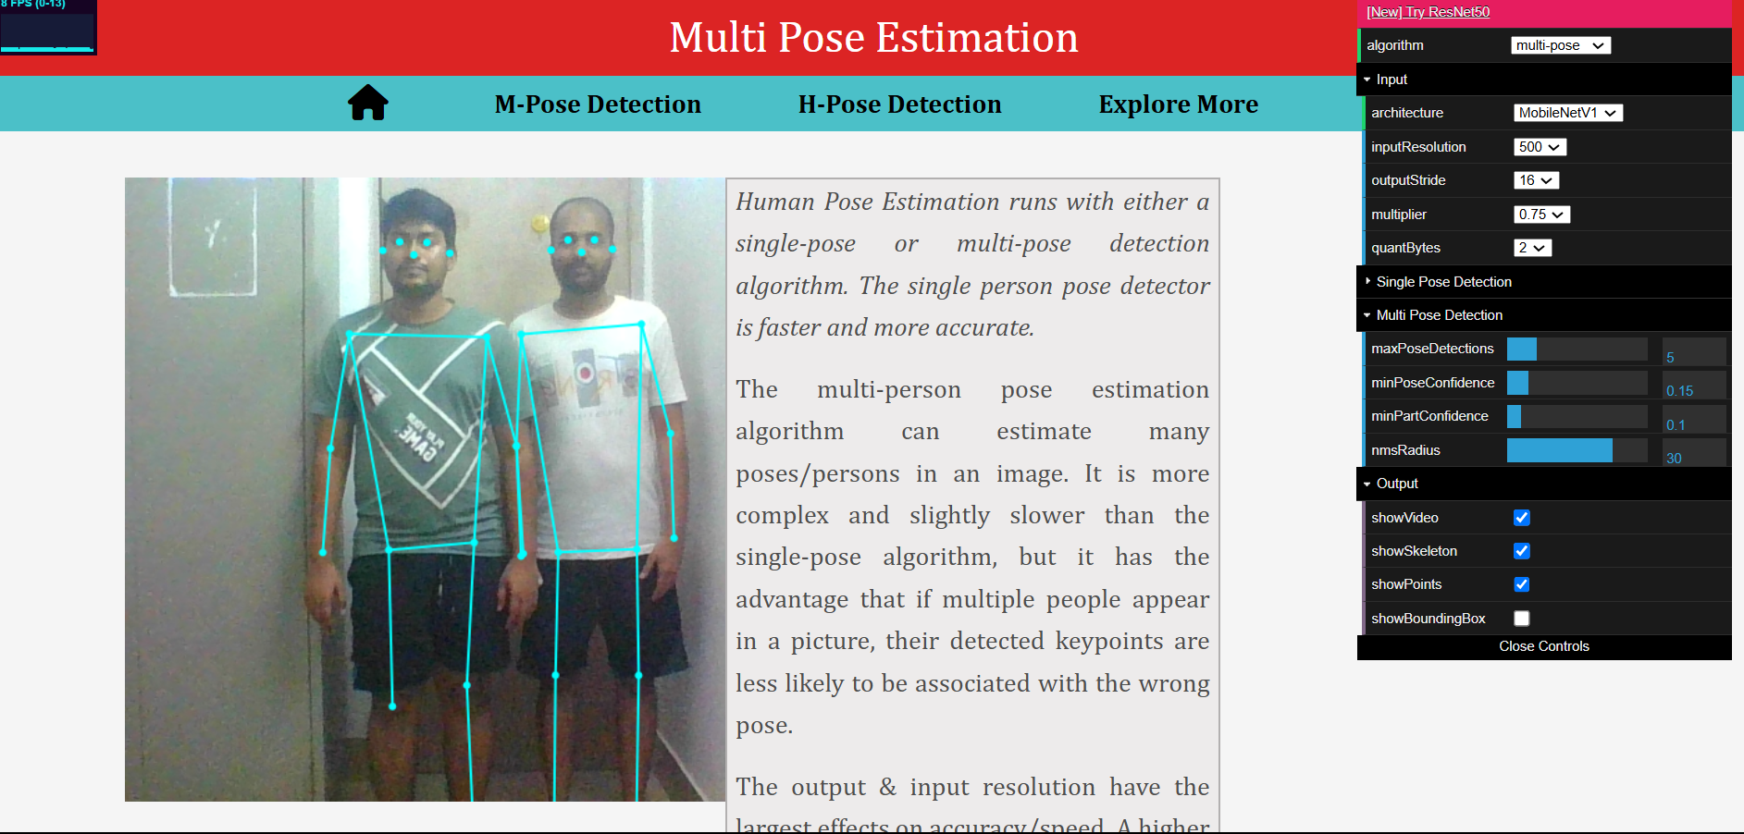
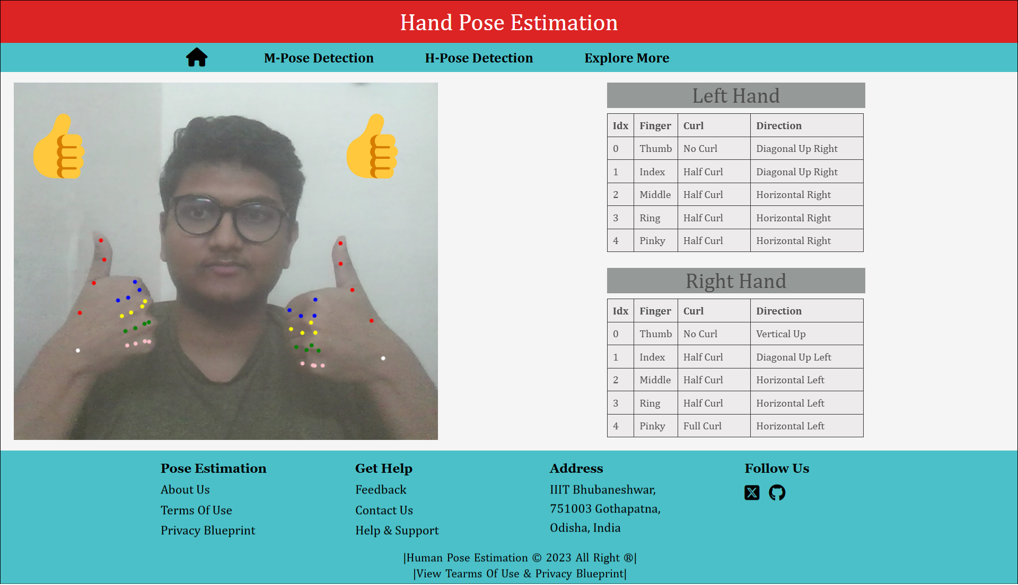
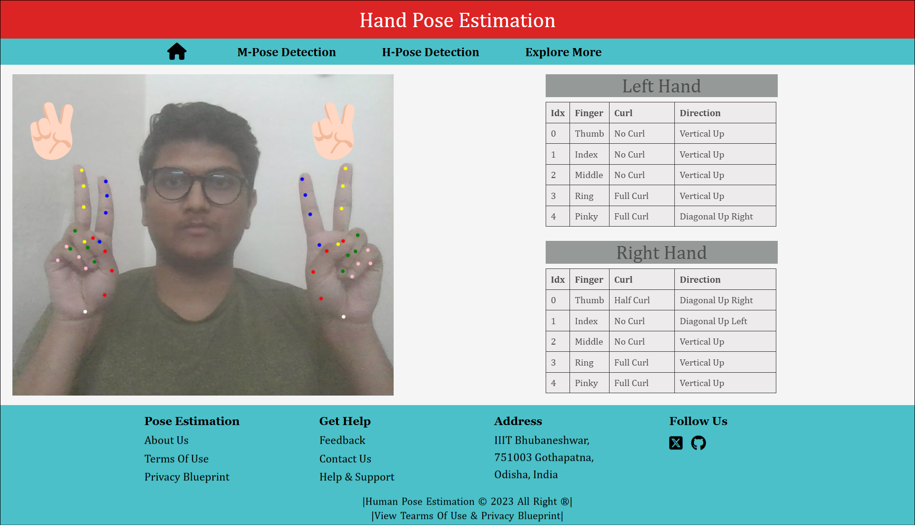
Types of pose estimation

Slide 7
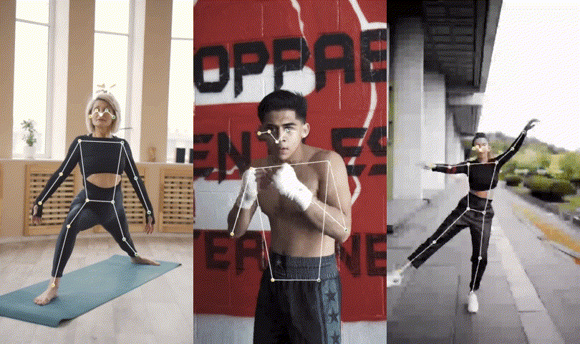
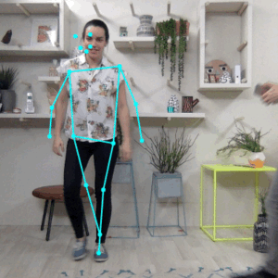
Single pose & multi pose estimation
Pose estimation can operate in two modes :
Single Pose Estimation – Detects the pose of only one people in an image/ video.
Multi Pose Estimation – Detects the poses of multiple people in an image/ video.

Slide 8
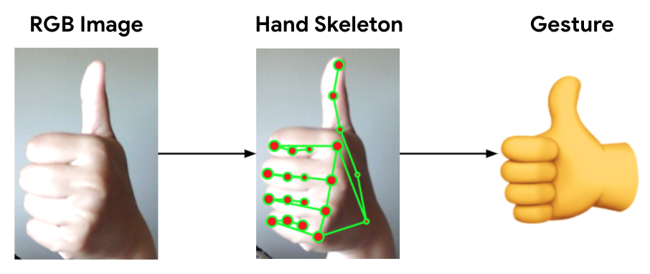
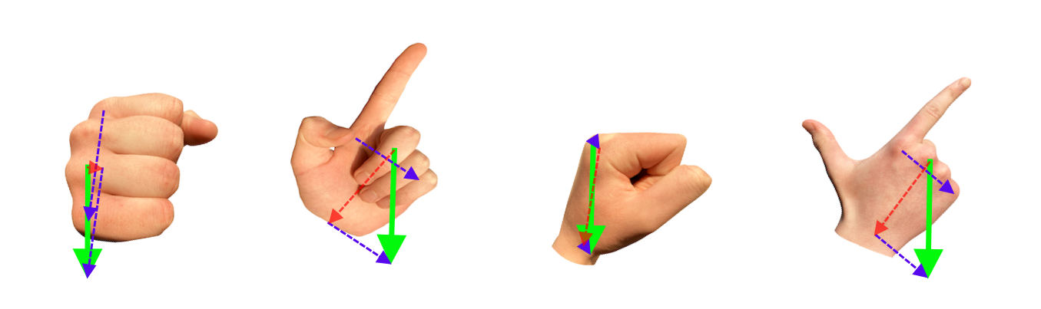
Hand pose estimations

Slide 9
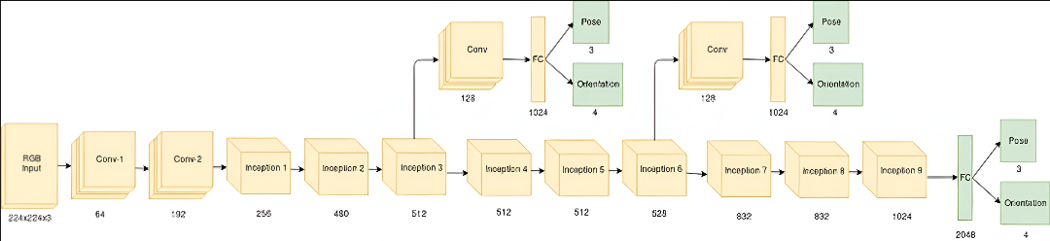
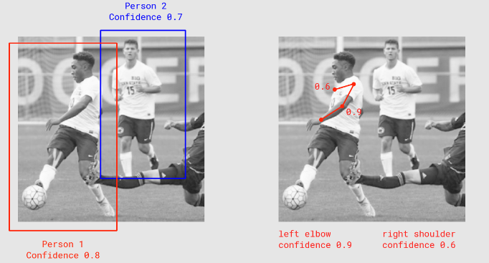
Pose Net architecture
Key Terminologies :
Pose
Pose Confidence Score
Keypoint
Keypoint Confidence Score
Keypoint Position

Slide 10
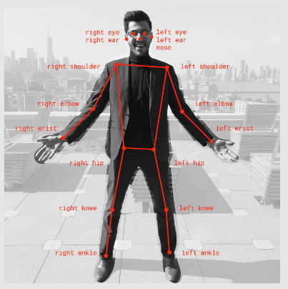
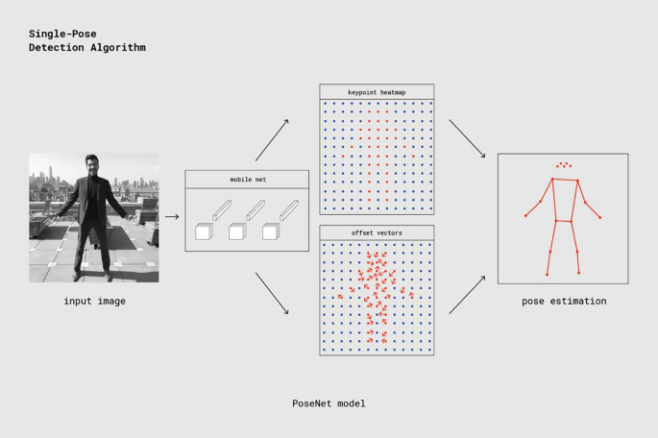
Algorithms
Fig - 17 Pose Key points Returned By Posenet
Fig - Single person pose detector pipeline using PoseNet

Slide 11
Estimating Poses from the Outputs of the Model
Key points Detection Steps :
Sigmoid Activation applied to heatmap to obtain key point scores
Argmax2D used to find (y, x) index with highest score for each key point
Offset Vectors retrieved for each key point using corresponding heatmap indices
Final Key point Positions computed using output stride and offset vectors
Key point Confidence = score at heatmap position
Pose Confidence = average of all key point confidence scores

Slide 12
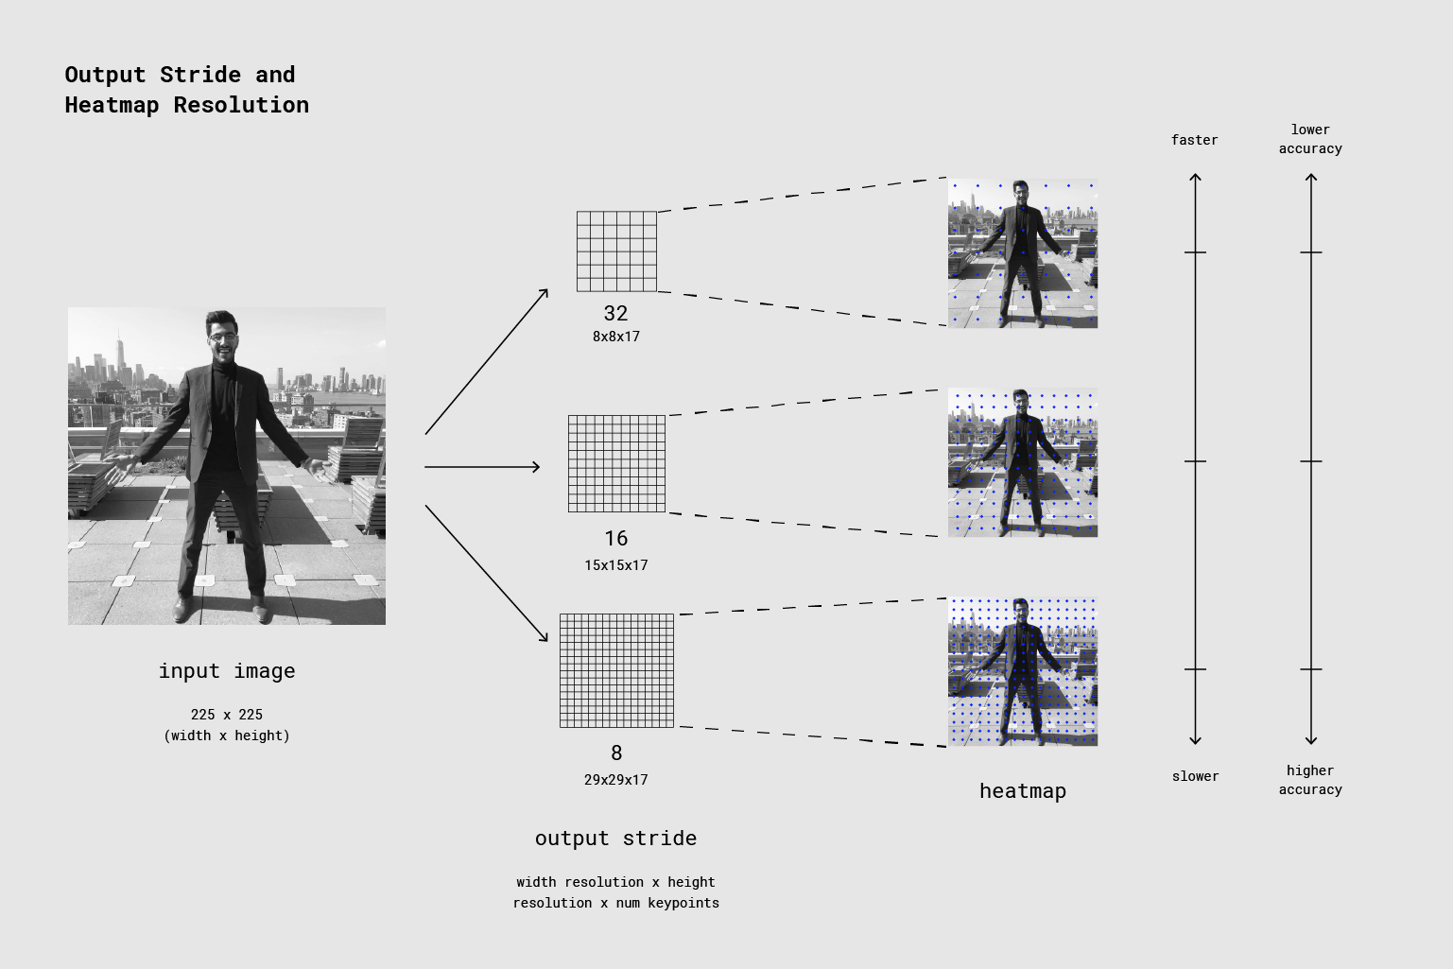
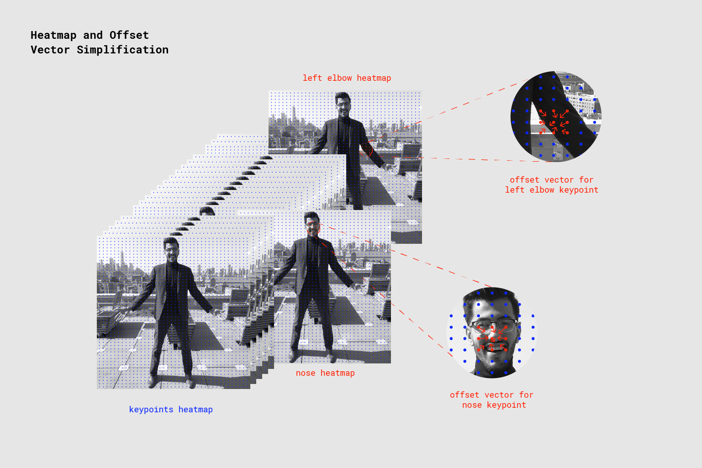
Algorithms
Fig - Processing Model Inputs: an Explanation of Output Strides
Fig - Model Outputs: Heatmaps and Offset Vectors

Slide 13
Libraries/ frameworks/ models
Following are the technologies that we had used to implement the real time human pose estimation project in web browser .
TensorFlow
Mediapipe
Posenet

Slide 14
tensorflow
Definition: A JavaScript library for training and deploying ML models in the browser and Node.js.
Overview of features:
Supports high-level APIs and pre-trained models
Enables browser-based model execution
Facilitates interactive ML-powered applications
Official Links: https://www.tensorflow.org/
Datasets Used :
COCO , MPII for pose estimation
300W-LP for face detection
Hand Tracking 21-Keypoint for hand pose tracking

Slide 15
Media-pipe
Definition: Open-source ML framework by Google for real-time processing of video, images, and audio.
Key features:
Supports cross-platform deployment: Web, Android, iOS, Desktop
Optimized for low-latency inference on CPU & GPU
Modular pipeline for efficient multi-task learning
Ideal for AR, gaming, healthcare, and other AI applications
Official Link : Media-Pipe

Slide 16
posenet
Definition:
A real-time human pose estimation model by Google.
Detects key points like nose, eyes, shoulders, elbows, etc., from images or videos.
Key features:
Optimized for mobile and web apps
Runs directly in browsers via TensorFlow.js
Supports CPU, GPU, and WebGL acceleration
Suitable for interactive and low-latency applications
Official Link: Posenet

Slide 17
FLOW OF THE PROJECT
S.No. | Flow
1 | Data Collection And Data Preprocessing
2 | Model Selection
3 | Integration with Web Browser
4 | User Input
5 | Inference
6 | Visualization
7 | Optimization
8 | Testing
9 | Deployment

Slide 18
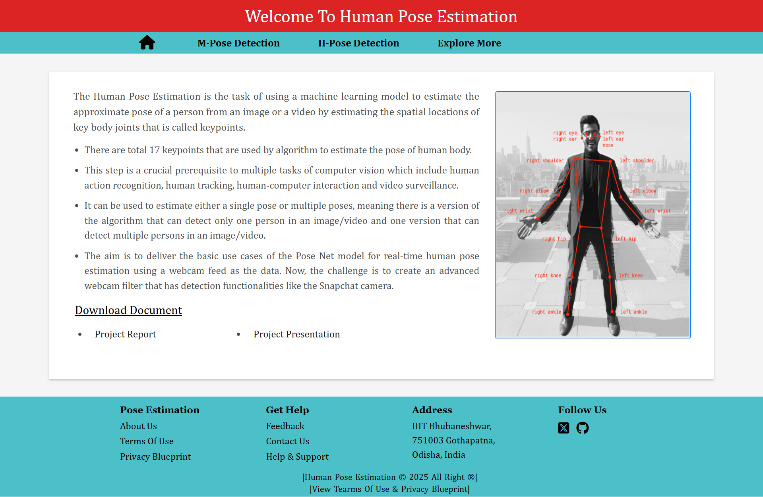
WEBSITE HOMEPAGE
Links :
Repository
Website

Slide 19
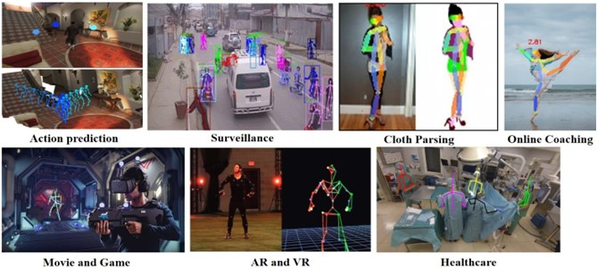
USE CASES

Slide 20
FUTURE SCOPES
S.No. | Future Scopes
1 | Real – Time Pose Estimation on Edge Devices
2 | Privacy and Security Considerations
3 | Real – Time Feedback and Coaching
4 | Collaborative Pose Estimation
5 | Supervised Learning
6 | Virtual Try – On and Fashion
7 | 3D Pose Estimation

Slide 21
CONCLUSION
Demonstrated basic PoseNet use cases with real-time webcam input.
Real-Time human pose estimation uses CV + ML to track joint positions and orientation.
Widely applicable in:
Virtual Reality
Gaming
Sports Analytics
Health Monitoring

